Slide 1

MU5MEF16 - (MEC 655) Numerical Methods for Fluid Mechanics
CompMech and Fluid Mechanics
Collapse of a column of grain
DUVIVIER Valentin - DELHAYE Victor
10/04/2021

Slide 2
Plan
Introduction
System’s physics : solid/fluid modelisation
A. PI theorem
B. Numerical model
scale invariance behavior
viscous behavior
Summarizing collapse behavior
Conclusion

Slide 3



Introduction
Particularity model of fluid dynamic for solids
Theory to numerical
Same approach with avalanches, rock falls

Slide 4
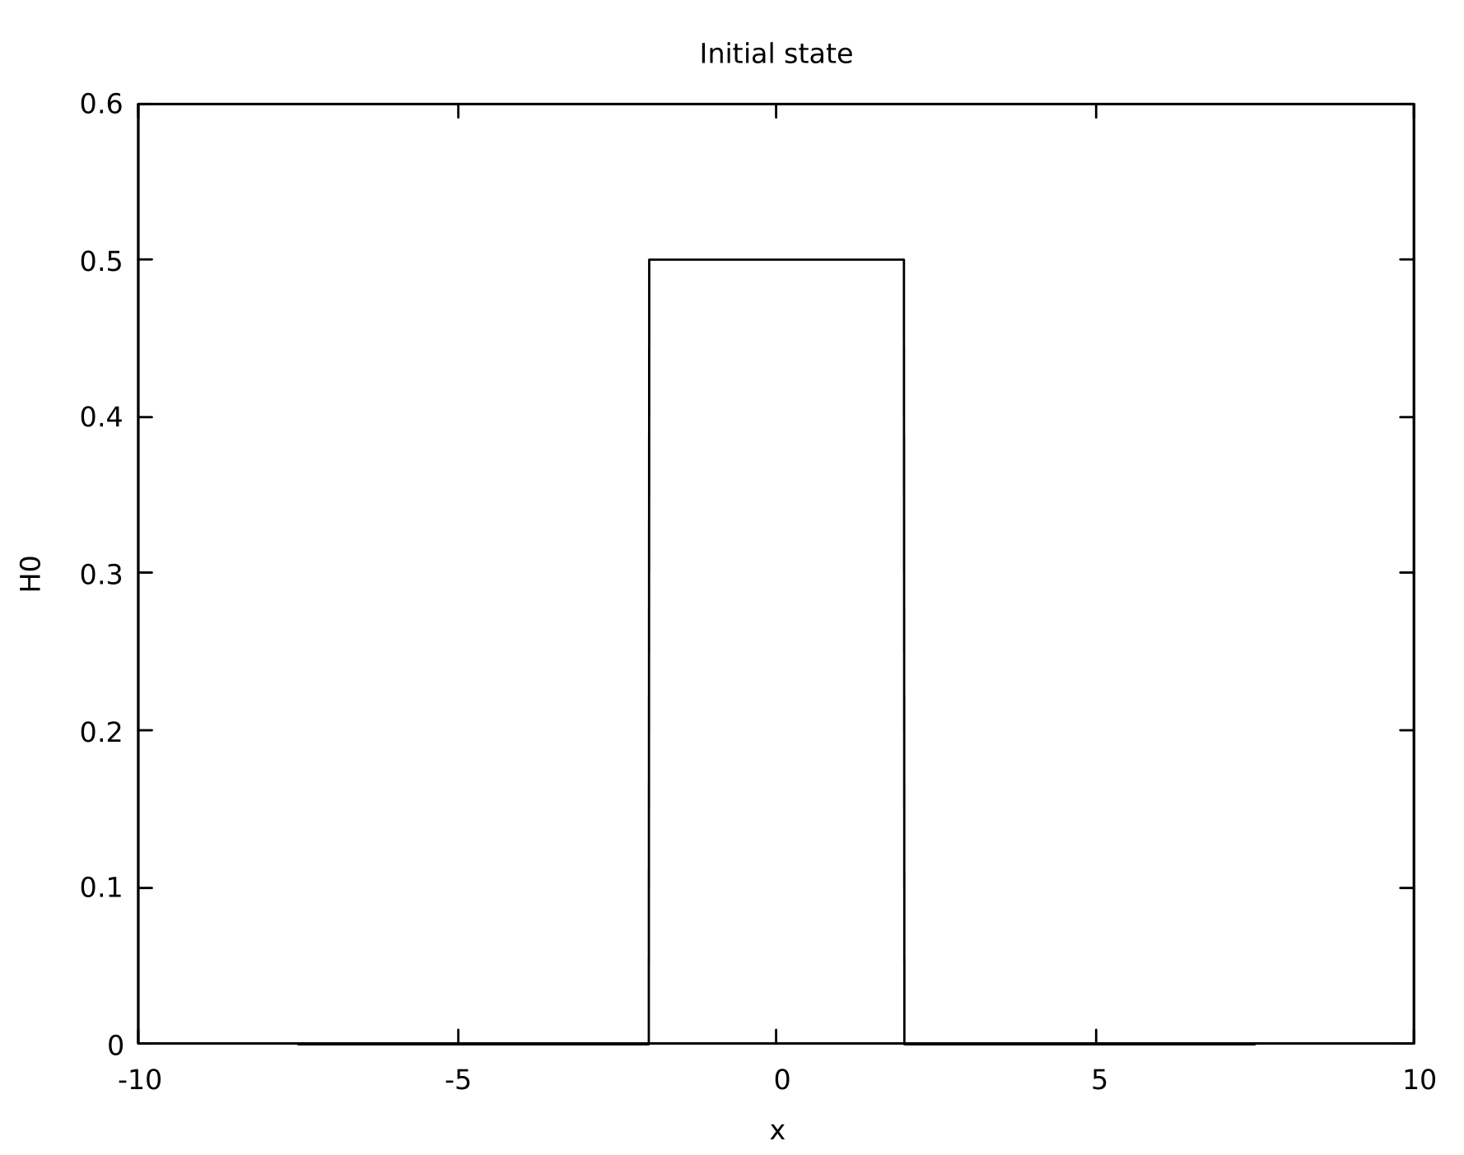
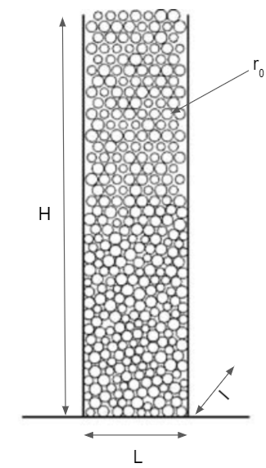
System’s physics
V_{grain} << V_{column}
fig 1. solid system
fig 2. fluid system

Slide 5
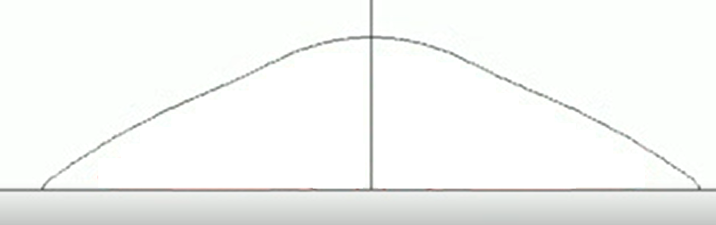
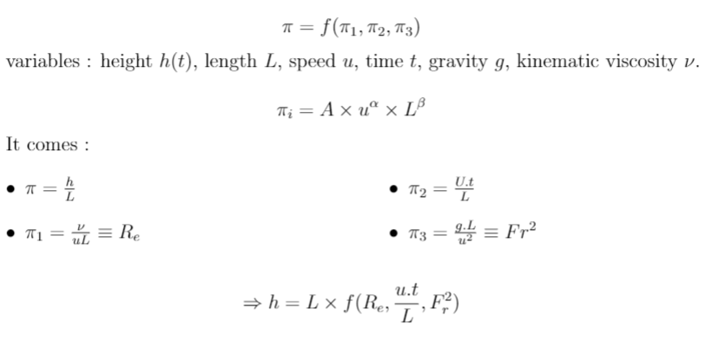
Buckingham-PI theorem
u(t)
-g.e_{z}
fig 3. Current state of column collapse
h(t)
L(t)

Slide 6
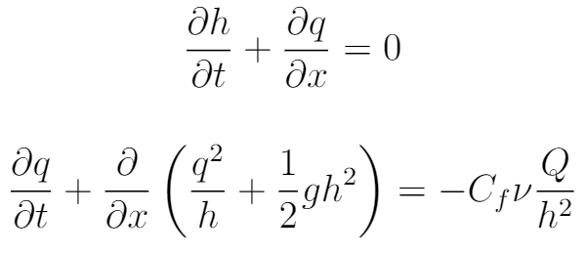
Shallow Water model
Conservative form of SW equations
mass conservation
movement quantity conservation
Convective terms
Poiseuille viscous term
We ensure convergence
→ numerical scheme
implicit
corrective

Slide 7
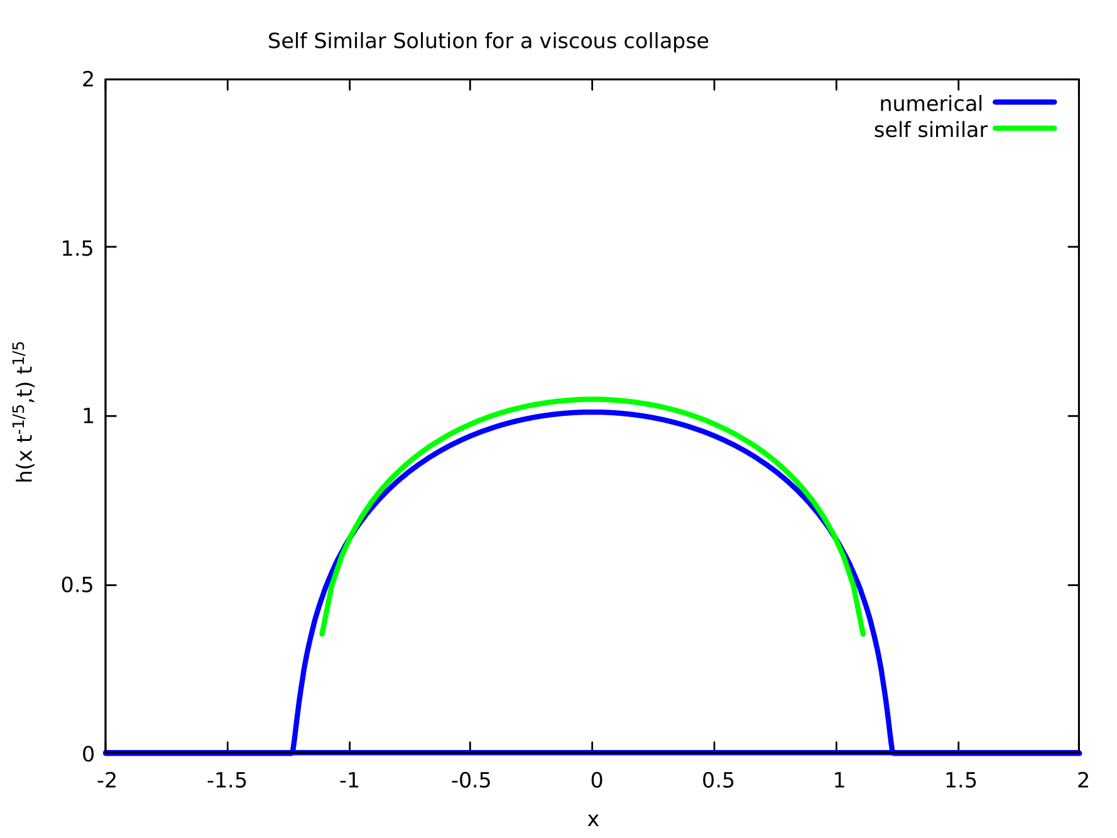
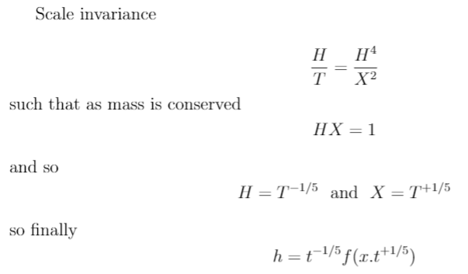
Scale invariance
fig 4. self similar function and numerical solution
The model responds well to the differential system

Slide 8
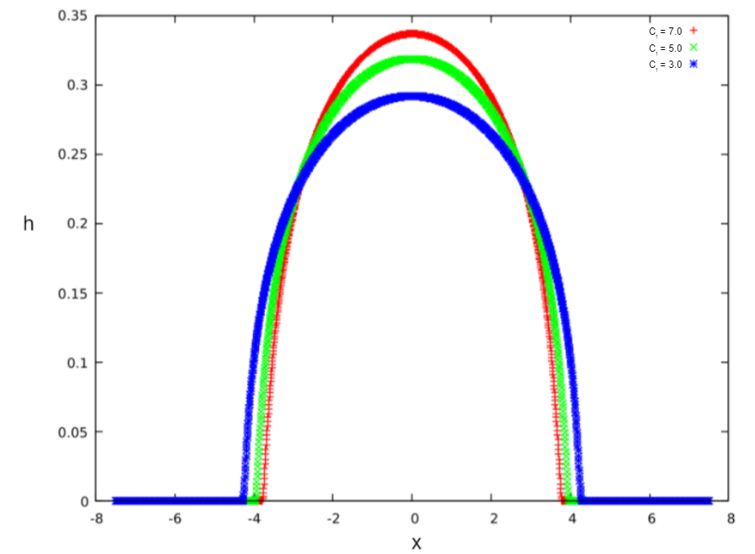
viscosity
How collapse is affected by viscosity ? How much ?
fig 5. Collapse as a function of viscosity

Slide 9
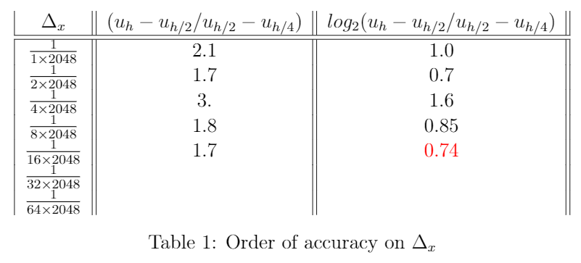
Convergence rate
Convergence rate space
Convergence rate time
Solving with dynamic dt → ensures stability, non constant

Slide 10
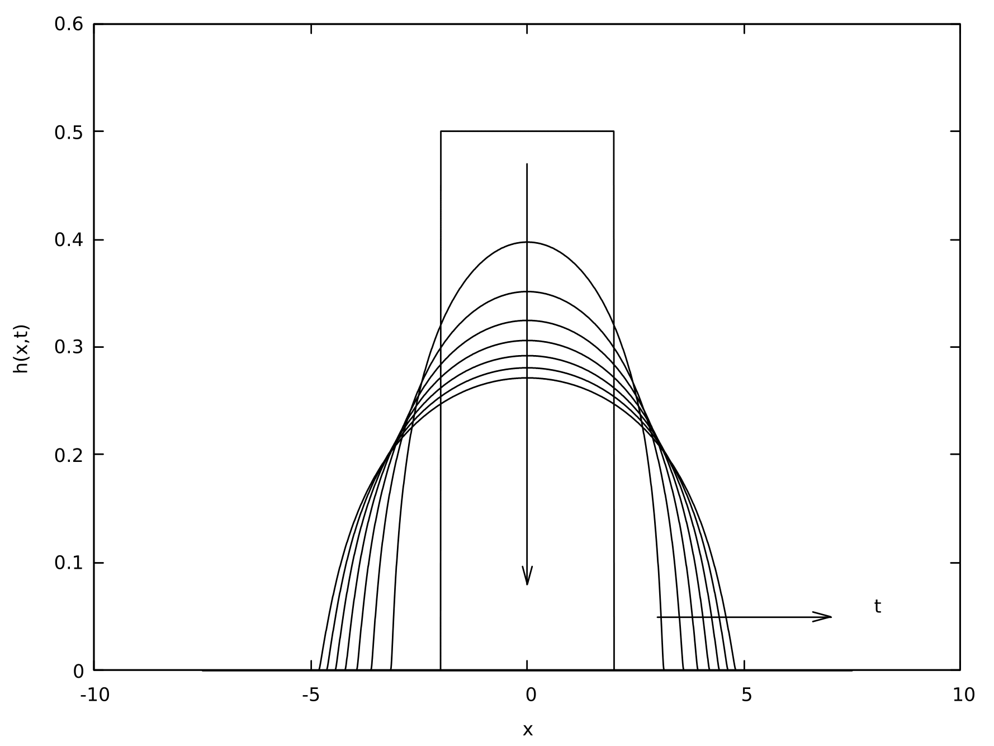
Conclusion
fluid behavior by association
self similar at low speed
diffusion like behavior
t
fig 6. Collapse behavior

